Slide 1
Big Data and Hadoop
Rahul Agarwal
irahul.com

Slide 2
Attributions
Amr Awadallah: http://www.sfbayacm.org/wp/wp-content/uploads/2010/01/amr-hadoop-acm-dm-sig-jan2010.pdf
Hadoop: http://hadoop.apache.org/
Computerworld: http://www.computerworld.com/s/article/350908/5_Indispensable_IT_Skills_of_the_Future
Ashish Tushoo: http://www.sfbayacm.org/wp/wp-content/uploads/2010/01/sig_2010_v21.pdf
Big data: http://en.wikipedia.org/wiki/Big_data
Chukwa: http://www.cca08.org/papers/Paper-13-Ariel-Rabkin.pdf
Dean, Ghemawat: http://labs.google.com/papers/mapreduce.html

Slide 3
Agenda
Big Data Problem
What is Hadoop
HDFS
MapReduce
HBase
PIG
HIVE
Chukwa
ZooKeeper
Q&A

Slide 4

Why?
Notes:
Analyzing large amounts of data is the top predicted skill required!

Slide 5
Big Data
Extremely large datasets that are hard to deal with using Relational Databases
Storage/Cost
Search/Performance
Analytics and Visualization
Need for parallel processing on hundreds of machines
ETL cannot complete within a reasonable time
Beyond 24hrs – never catch up

Slide 6
Hadoop design principles
System shall manage and heal itself
Automatically and transparently route around failure
Speculatively execute redundant tasks if certain nodes are detected to be slow
Performance shall scale linearly
Proportional change in capacity with resource change
Compute should move to data
Lower latency, lower bandwidth
Simple core, modular and extensible

Slide 7
What is Hadoop
A scalable fault-tolerant grid operating system for data storage and processing
Commodity hardware
HDFS: Fault-tolerant high-bandwidth clustered storage
MapReduce: Distributed data processing
Works with structured and unstructured data
Open source, Apache license
Master (named-node) – Slave architecture

Slide 8
Hadoop Projects
ETL Tools
BI Reporting
Pig (Data Flow)
Hive (SQL)
MapReduce (Job Scheduling/Execution System)
ZooKeeper (Coordination)
HBase (key-value store)
(Streaming/Pipes APIs)
Chukwa (Monitoring)
HDFS (Hadoop Distributed File System)

Slide 9
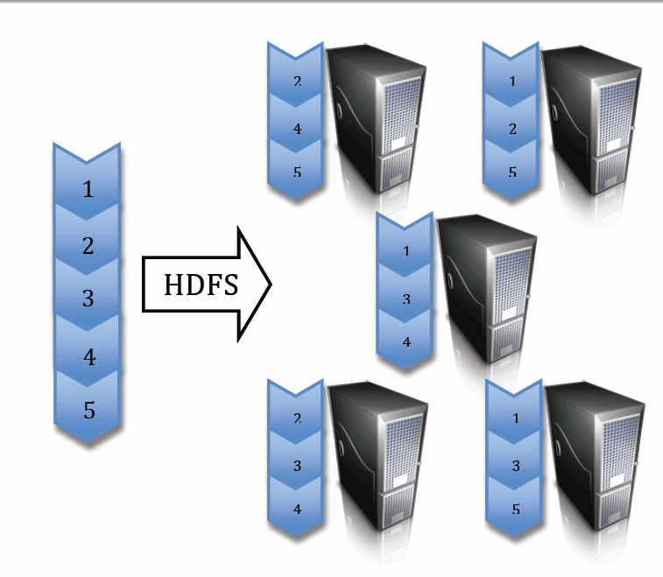
HDFS: Hadoop Distributed FS
Block Size = 64MB
Replication Factor = 3
Notes:
Pool commodity servers in a single hierarchical namespace.
Designed for large files that are written once and read many times.
Example here shows what happens with a replication factor of 3, each data block is present in at least 3 separate data nodes.
Typical Hadoop node is eight cores with 16GB ram and four 1TB SATA disks.
Default block size is 64MB, though most folks now set it to 128MB

Slide 10
MapReduce
Patented Google framework
Distributed processing of large datasets
map (in_key, in_value) -> list(out_key, intermediate_value)
reduce (out_key, list(intermediate_value)) -> list(out_value)

Slide 11
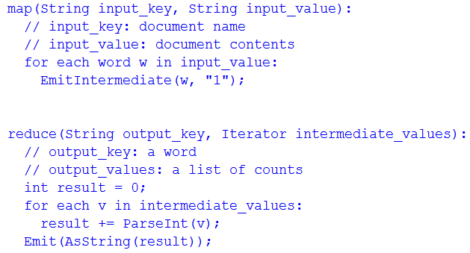
Example: count word occurences

Slide 12
HBase
“Project's goal is the hosting of very large tables - billions of rows X millions of columns - atop clusters of commodity hardware”
Hadoop database, open-source version of Google BigTable
Column-oriented
Random access, realtime read/write
“Random access performance on par with open source relational databases such as MySQL”

Slide 13
PIG
High level language (Pig Latin) for expressing data analysis programs
Compiled into a series of MapReduce jobs
Easier to program
Optimization opportunities
grunt> A = LOAD 'student' USING PigStorage() AS (name:chararray, age:int, gpa:float); grunt> B = FOREACH A GENERATE name;

Slide 14
HIVE
Managing and querying structured data
MapReduce for execution
SQL like syntax
Extensible with types, functions, scripts
Metadata stored in a RDBMS (MySQL)
Joins, Group By, Nesting
Optimizer for number of MapReduce required
hive> SELECT a.foo FROM invites a WHERE a.ds='<DATE>';

Slide 15
ZooKeeper
A highly available, scalable, distributed, configuration, consensus, group membership, leader election, naming, and coordination service
Cluster Management
Load balancing
JMX monitoring

Slide 16
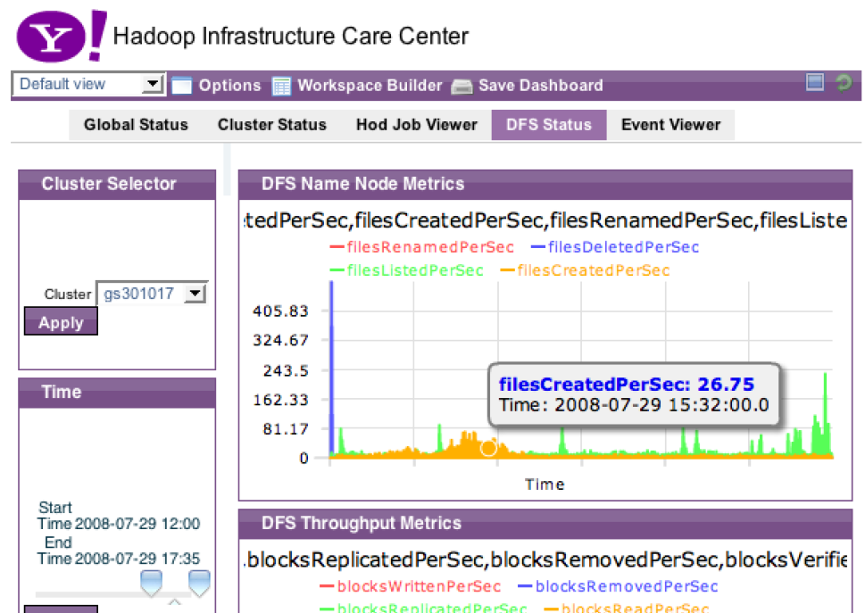
Chukwa
Data collection system for monitoring distributed systems
Agents to collect and process logs
Monitoring and analysis
Hadoop Infrastructure Care Center

Slide 17
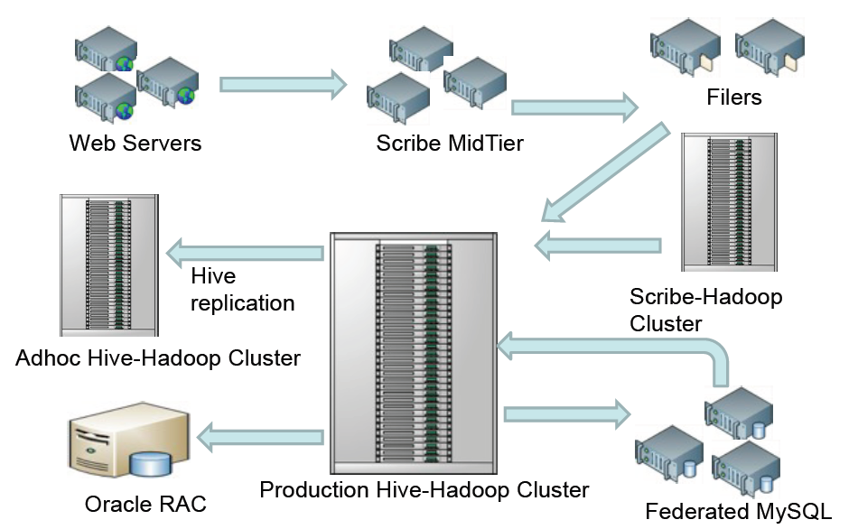
Data Flow at Facebook
Notes:
Example flow as at Facebook

Slide 18
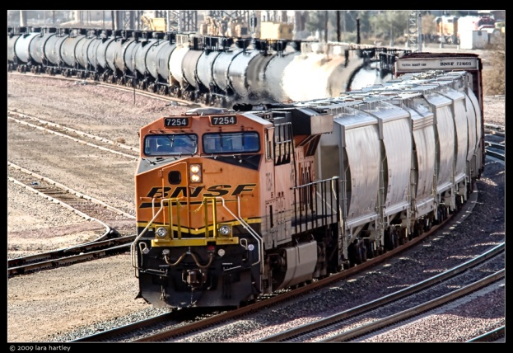
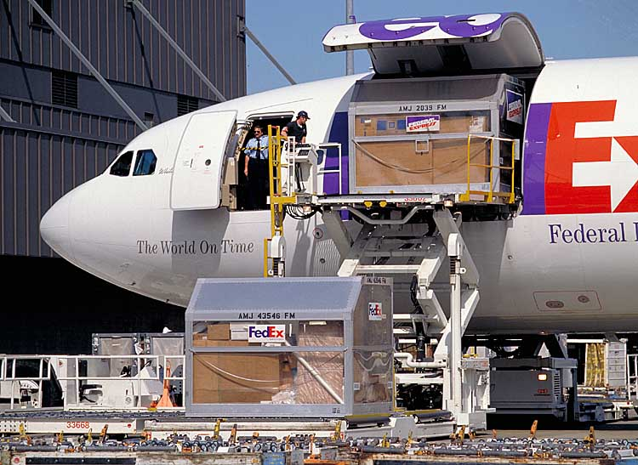
Choose the right tool
Hadoop
Affordable Storage/Compute
Structured or Unstructured
Resilient Auto Scalability
Relational Databases
Interactive response times
ACID
Structured data
Cost/Scale prohibitive
Notes:
Aircraft is refined, very fast, and has a lot of addons/features. But it is pricey on a per bit basis and is expensive to maintain
Cargo train is rough, missing a lot of “luxury”, slow to accelerate, but it can carry almost anything and once it gets going it can move a lot of stuff very economically

